Slide 1
Pre-Health Research Journal Club Presentation

Slide 2
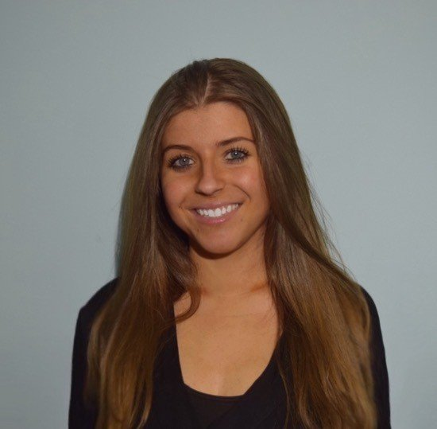

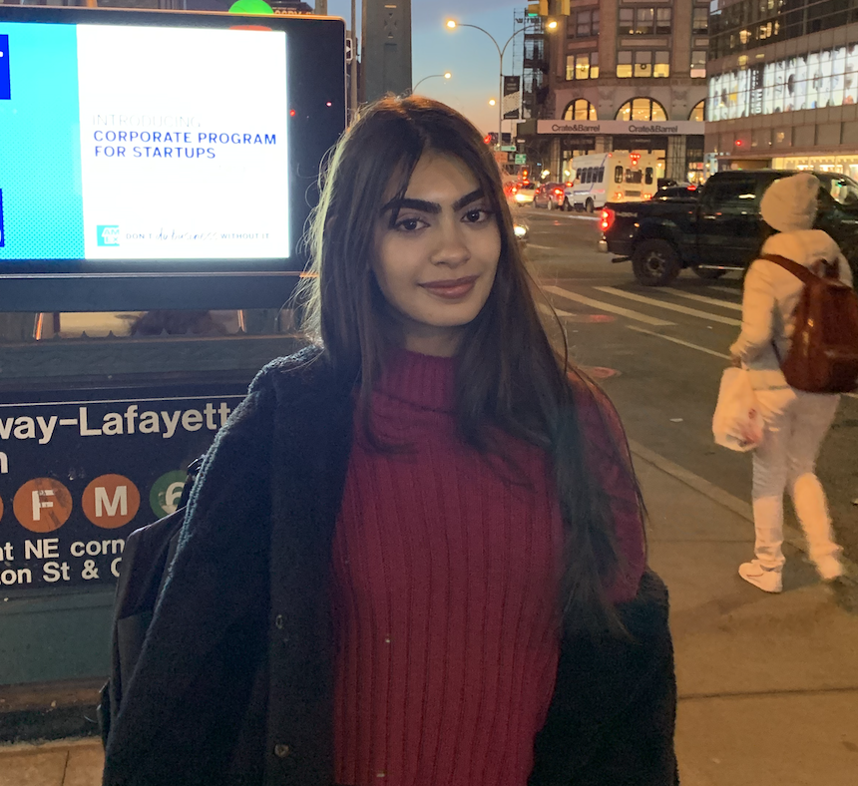

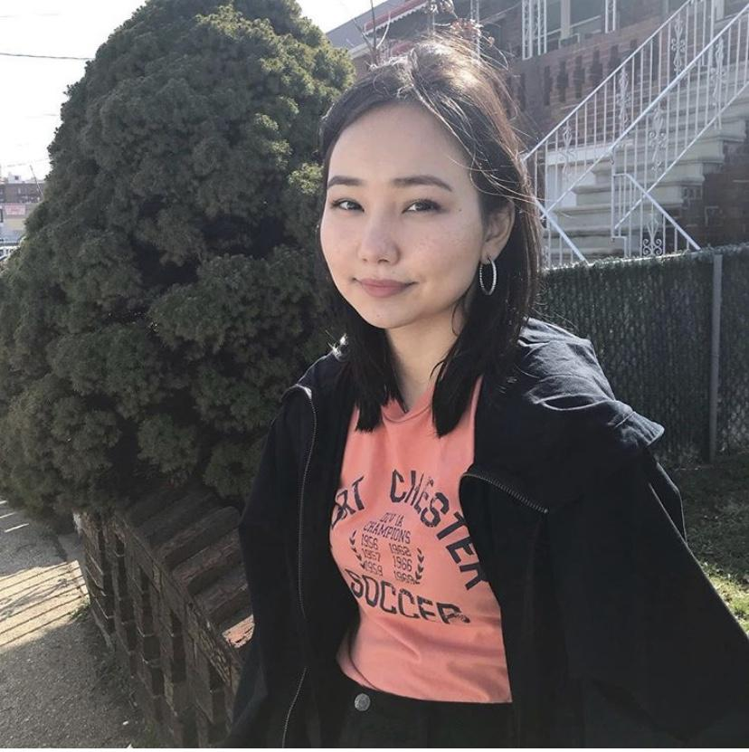
FOUNDERS/MENTORS
Natalya
Krutovska
Deepshikha
Kewlani
Mahnoor Memon
Zaina
Syed
Alia Isabekova

Slide 3
Welcome!
Agenda for today:
2 Student led presentations followed by discussions
Discussions will include
COVID-19 vaccine research
Using CRISPR to combat COVID-19
Contact info:
Email: hunterjournalclub@gmail.com
Ig: @hunterjournalclub

Slide 4
ListServ!
https://forms.gle/JQTBxE2jrcQ53tzs8

Slide 5
Receptor usage and cell entry of bat coronavirus HKU4
provide insight into bat-to-human transmission of
MERS coronavirus
Yang Yanga,1, Lanying Dub,1, Chang Liua,1, Lili Wangb, Cuiqing Mab, Jian Tangb, Ralph S. Baricc, Shibo Jiang Md,2, and Fang Lia,2
Presented by Faria Haq

Slide 6
MERS coronavirus
Coronavirus surveillance studies have suggested that MERS-CoV originated from animals, with bats as the likely natural reservoir.
Understanding the pathogenesis and potential cross-species transmissibility of these bat coronaviruses is critical for evaluating long-term emerging disease potentials and for preventing and controlling the spread of bat-originated coronaviruses in humans.
This study investigates the receptor usage and cell entry mechanisms of HKU4 and HKU5, providing insight into how MERS- CoV and MERS-related bat coronaviruses can cross species barriers, adapt to human cells, and gain infectivity in humans.

Slide 7
Receptor Recognition And Membrane Fusion
An envelope-anchored spike protein mediates coronavirus entry into host cells by first binding to a host receptor through its S1 subunit and then fusing the host and viral membranes via its S2 subunit.
Specific RBD (receptor-binding domain) in MERS-CoV spike S1 subunit binds human DPP4 with high affinity. This means that the binding of the coronavirus to the host receptor is occuring.
MERS-CoV RBD shares 56% and 54% sequence similarity with the corresponding S1 domain in HKU4 and HKU5 however, residue changes occur.
Coronavirus entry into host cells is limited by receptor recognition and also by membrane fusion.
However, the mechanisms for human cell entry by bat coronaviruses are poorly understood, leaving a critical missing link in the bat-to-human transmission of coronaviruses. Therefore, examining the cell entry of HKU4 and HKU5 can provide novel knowledge of the causes of MERS-CoV (and SARS-CoV) infections in humans.

Slide 8
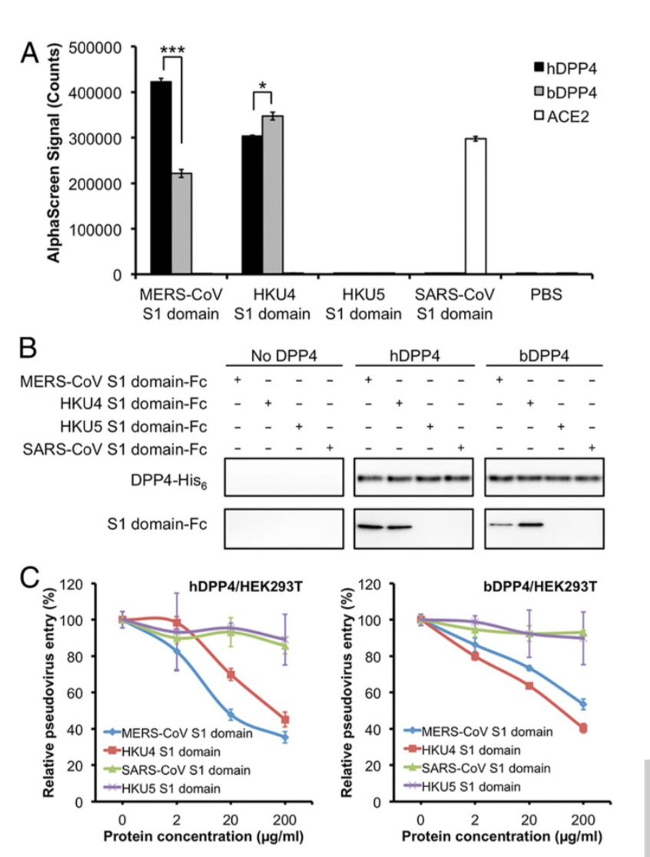
AlphaScreen protein–protein binding assay
AlphaScreen protein–protein binding assay showed that whereas the MERS-CoV S1 domain bound human DPP4 (hDPP4) with significantly higher affinity than it bound bat DPP4 (bDPP4), the corresponding HKU4 S1 domain bound bDPP4 slightly better than it bound hDPP4 (Fig. 1A). In contrast, the HKU5 S1 domain did not bind hDPP4 or bDPP4. As a control, the SARS-CoV S1 domain only bound its own receptor human angiotensin-converting enzyme 2, but not hDPP4 or bDPP4.

Slide 9
Pull-Down Assay
Pull-down assay revealed that hDPP4 was more efficient than bDPP4 at pulling down the MERS-CoV S1 domain from solution, whereas both hDPP4 and bDPP4 pulled down the HKU4 S1 domain efficiently (Fig. 1B). In contrast, neither hDPP4 nor bDPP4 pulled down the SARS-CoV or HKU5 S1 domain.

Slide 10
Pseudovirus inhibition assay
Pseudovirus inhibition assay demonstrated that the HKU4 S1 domain, but not the HKU5 or SARS-CoV S1 domain, inhibited MERS-CoV-spike-mediated pseudovirus entry into HEK293T cells exogenously expressing hDPP4 or bDPP4.
This indicates that the HKU4 S1 domain and MERS-CoV-spike-packaged pseudoviruses competed for the same DPP4 receptor on HEK293T cell surface

Slide 11
Conclusion
These results showed that the HKU4 S1 domain, but not the HKU5 S1 domain, binds both hDPP4 and bDPP4, and that the MERS-CoV S1 domain binds hDPP4 significantly better than it binds bDPP4, whereas the HKU4 S1 domain binds bDPP4 slightly better than it binds hDPP4. These results strongly suggest that HKU4 spike, but not HKU5 spike, uses DPP4 as its receptor and that the HKU4 S1 domain is the DPP4-binding RBD.

Slide 12
Significance
The researchers investigated the receptor usage and cell entry mechanism of HKU4 compared with MERS-CoV. The results reveal that MERS-CoV has adapted to use human receptor and cellular proteases for efficient human cell entry, whereas HKU4 can potentially follow up and also infect human cells. These findings are critical for evaluating emerging disease potentials of bat coronaviruses and for preventing and controlling their spread in humans.

Slide 13
Discussion
Rumors surrounding a microchip from Bill Gates in the coronavirus vaccine
“false story about a purported evil plan by Microsoft founder Bill Gates to use mass coronavirus vaccinations to implant microchips in billions of people to track their movements.” (USAtoday.com)
From these conspiracies, health officials worry that it might cause Americans to decide against getting vaccinated against SARS-CoV-2
New mRNA vaccine (mRNA-1273) encodes the stabilized prefusion of SARS-CoV-2 spike protein
“phase 1, dose-escalation, open-label trial including 45 healthy adults, 18 to 55 years of age, who received two vaccinations, 28 days apart, with mRNA-1273 in a dose of 25 μg, 100 μg, or 250 μg. There were 15 participants in each dose group”
“The mRNA-1273 vaccine induced anti–SARS-CoV-2 immune responses in all participants, and no trial-limiting safety concerns were identified”
Side effects: fatigue, chills, headache, myalgia, and pain at the injection site

Slide 14
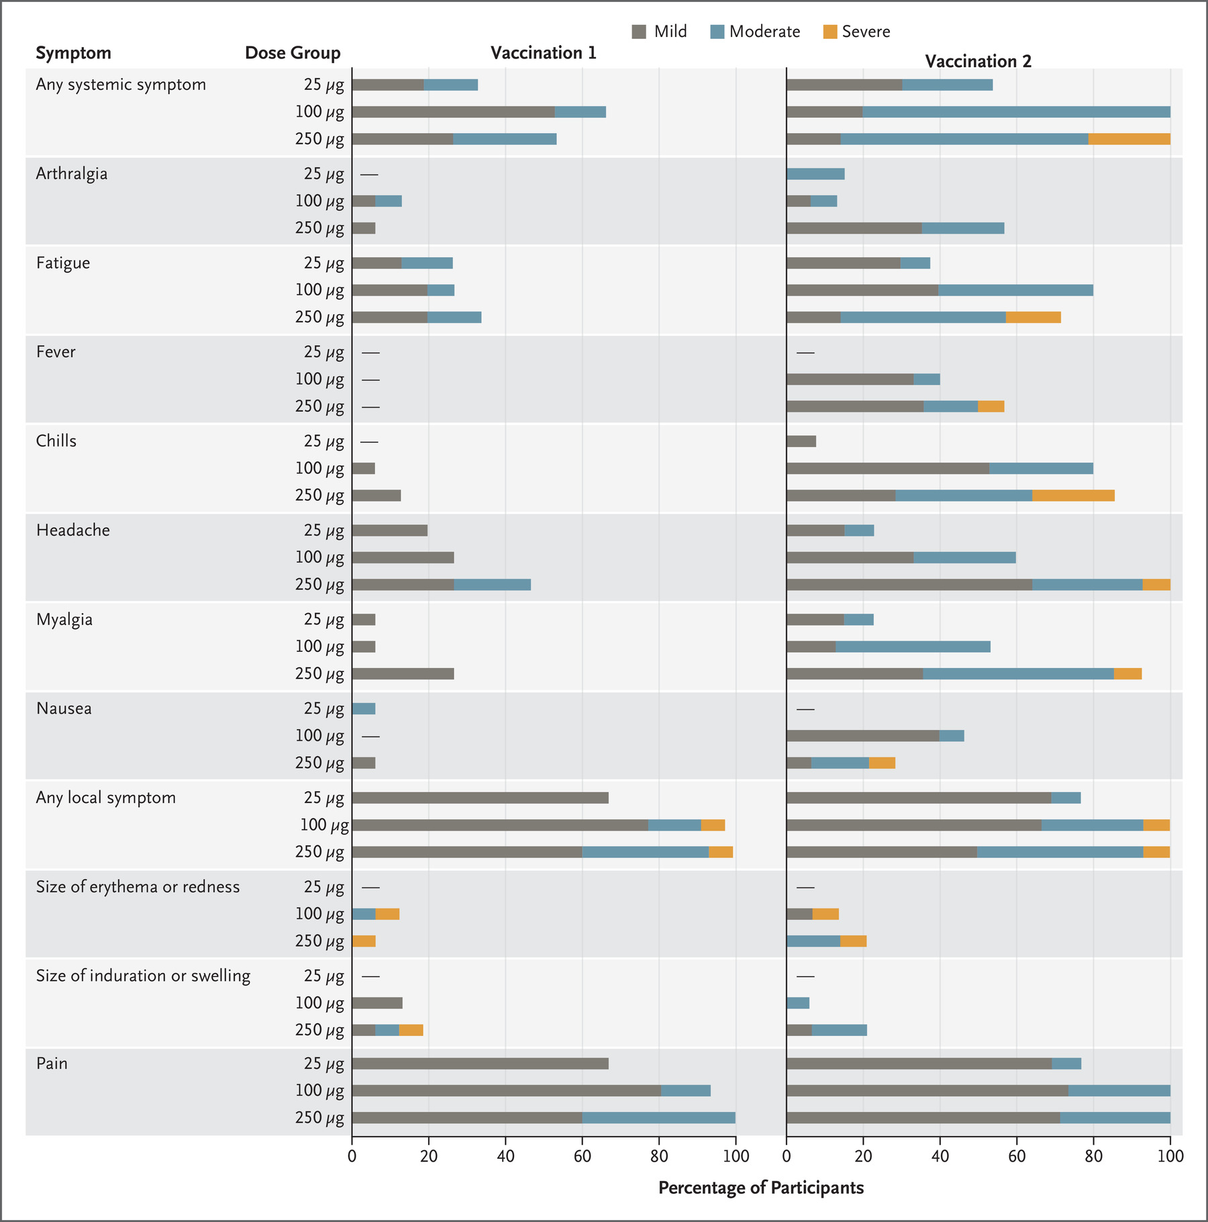
Questions
Do you feel that the conspiracy behind the microchip would personally prevent you from receiving a vaccine?
As for the mRNA vaccine, is there any anticipation of long-term adverse effects that can come about?
In terms of accessibility to the vaccine, who would be at the top of the priority list, and how would access be regulated?

Slide 15
Summary: Correction of a pathogenic gene mutation in human embryos
Hong Ma, Nuria Marti-Gutierrez, Sang-Wook Park & Jun Wu
Center for Embryonic Cell and Gene Therapy, Oregon Health & Science University
Published in Journal: Nature
Presented By: Afsana Rahman

Slide 16
Outline
Purpose of Experiment.
Key Terms & Definitions to Know
Experiment Construction & Results
Evaluation & Critique
Summary

Slide 17
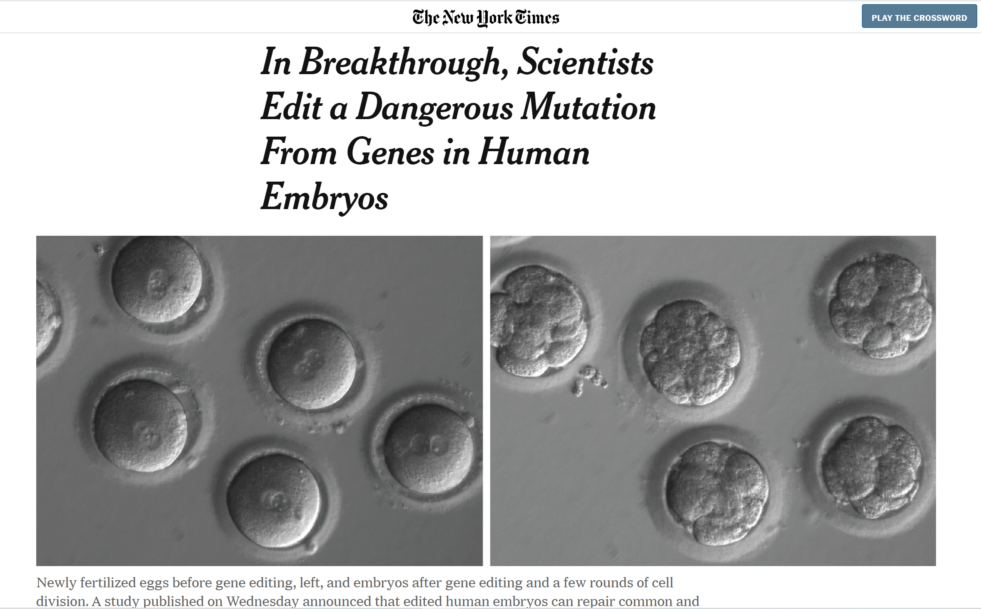
How Did I Find This Article? The New York Times!
Hunter students get free access to NY Times with a student email address! Utilize it! Get the app. They have a science and health category with trending articles.

Slide 18
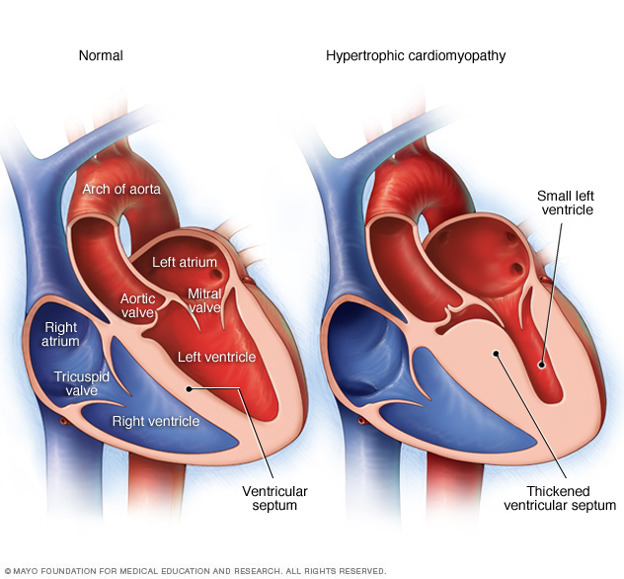
Brief Overview- Goal of Experiment
Mutation in gene MYBPC3 (4 base pair- (GAGT) deletion) causes hypertrophic cardiomyopathy (HCM), a condition where heart muscle is thick, not allowing proper blood flow and can lead to complications like heart failure or death.
HCM is the most common cause of sudden cardiac death in young athletes worldwide & can cause physiological and psychological problems impacting quality of life.
Current treatment options only provide symptom relief and does not address gene mutation.
In this experiment, scientists will use the CRISPR-CAS9 system to correct heterozygous mutant embryos.
Heterozygous Gene Mutation: Means that one allele carriers the mutation; in this experiment, the sperm allele is affected. The wild type allele is the maternal allele.
From Mayo Clinic

Slide 19
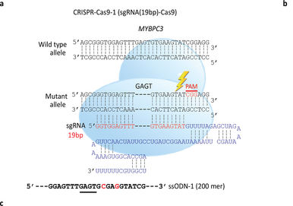
Background Information
CRISPR-CAS9 System
-CRISPR-Cas9 is a unique technology that enables geneticists and medical researchers to edit parts of the genome by removing, adding, or altering sections of the DNA sequence.
It is currently the simplest, most versatile, and precise method of genetic manipulation.
CRISPR-CAS9 consists of some key molecules (simplified):
-An enzyme called Cas9. This enzyme acts as a pair of ‘molecular scissors’ that can cut the two strands of DNA at a specific location in the genome. This allows from removal or addition of bits of DNA.
-A piece of guide RNA or gRNA. Made of ~20 bases complementary to the mutation, this guides the CAS9 enzyme to the right part of the genome to create the desired double-stranded cuts.
*Exogenous single-stranded oligodeoxynucleotide (ssODN) templates encoding homology arms to the targeted region were designed for each system to facilitate homology-directed repair in cells.
*A protospacer adjacent motif (PAM) is a 2–6-base pair DNA sequence immediately following the DNA sequence targeted by the Cas9 nuclease in the CRISPR bacterial adaptive immune system
Schematic Representation of CRISPR-CAS9 system for experiment

Slide 20
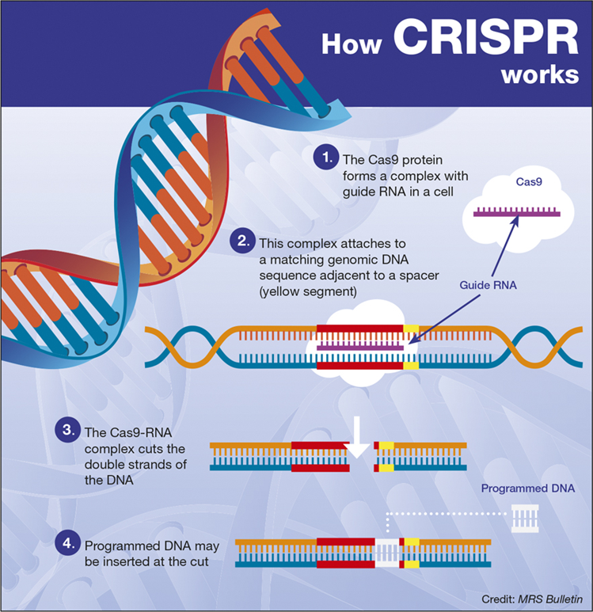
https://www.youtube.com/watch?v=Ft-160cAx38
START AT 10 SEC.From Cambridge University

Slide 21
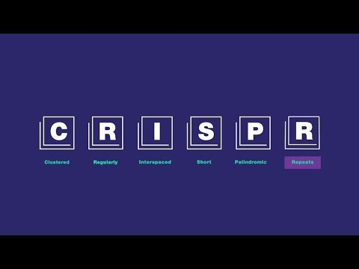

Slide 22
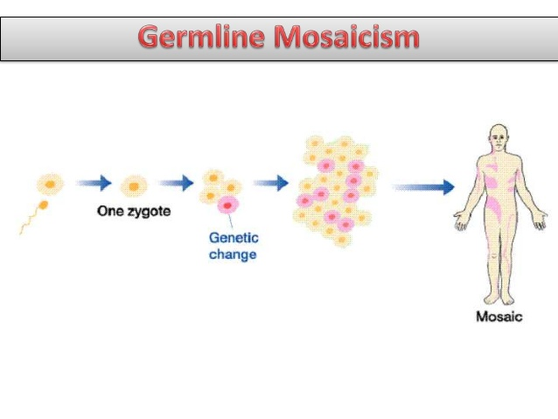
DNA Repair Systems & Other Definitions
Homology Directed Repair Pathway (HDR)
Rebuilds the Double-Stranded Break (DSBs) by either using the non-mutant homologous chromosome, or the supplied exogenous DNA molecule as template (provided by the CRISPR system)
Gene-edited embryos should be repaired like this. It does not introduce mutations.
Non-Homologous End Joining Repair Pathway (NHEJ)
Uses proteins to rebuild DSBs
Inappropriate for gene-editing because it introduces additional mutations in the form of insertions or deletions at the double-stranded Break.
Gene-edited embryos should not be repaired like this. This pathway can cause dangerous additional mutations to cells.
Mosaicism: Embryos that produce normal and abnormal cells, i.e cells have different genotypes.
From Ubooks.com
Blastomeres: Cells produced from zygote.
Oocytes: Female germline cell for reproduction.

Slide 23
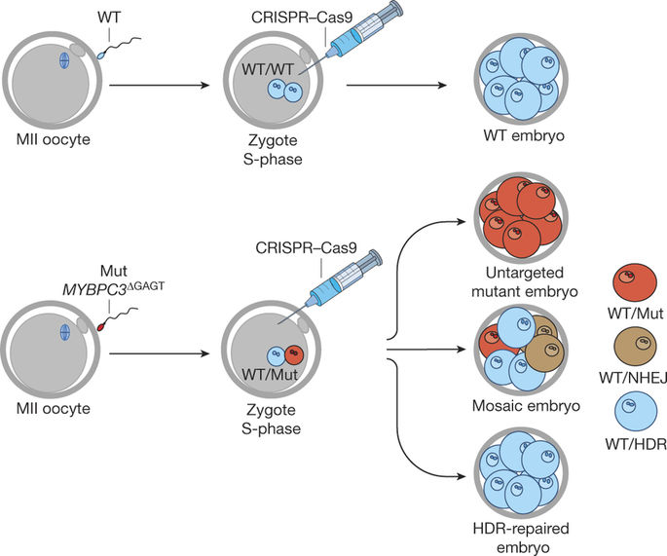
Summary of Main Experiments
Experiment 1: HDR efficiency in heterozygous MYBPC3 ∆GAGT zygotes
Sperm carries the mutation, not the oocyte.
Gene correction in S-phase-injected human embryos
- Scientists fertilized healthy donor oocytes with the sperm (from a heterozygous mutated patient) carrying the mutation.
-After three days, the CRISPR CAS9 system was injected 54 zygotes.
-Control Group: Zygotes that were infected with sperm that has no CRISPR-CAS9 system.
-36 (66.7%) were uniformly homozygous for the wild type allele, while 18 (33.3%) were uniform or mosaic heterozygous.
-Mosaic Embryos used the NHEJ pathway to repair.
Schematic Representation of Experiment from Results

Slide 24
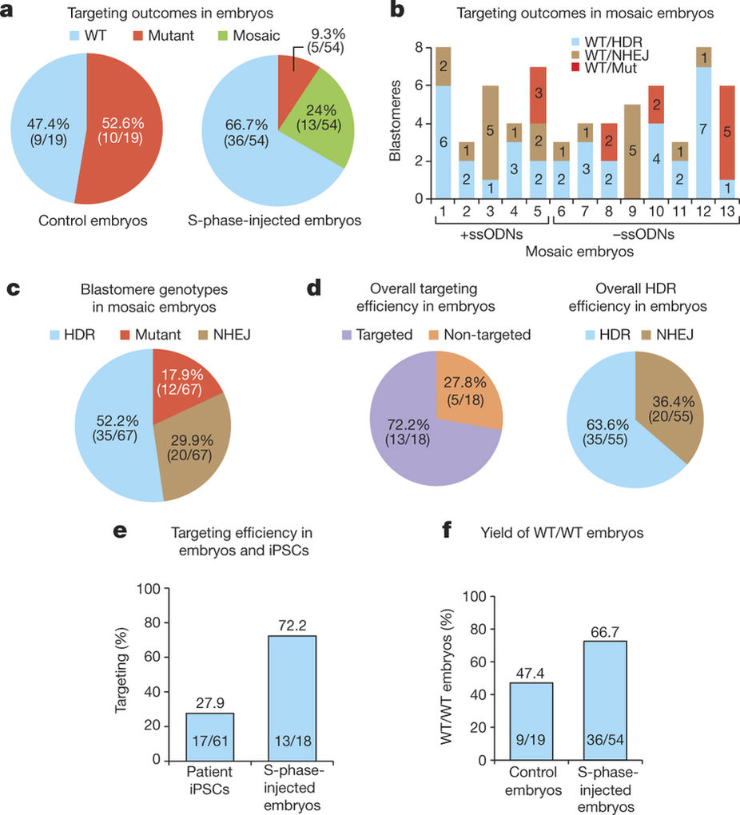
Results & Problems of First Experiment
Issues:
Mosaicism of human embryos is unacceptable for clinical applications.
Scientist’s Explanations:
at the time of injection, a zygote had completed the S-phase of the cell cycle with DNA replication and already produced two mutant alleles
CRISPR–Cas9 remained active, continuing to target after zygotic division.
Solution: CRISPR–Cas9 co-injected with sperm into the M-phase oocyte during fertilization by intracytoplasmic sperm injection (ICSI).
Genome editing occurs when sperm has single mutant copy- no mosaicism.
66.7% embryos were successfully gene-corrected. 63.6% of the blastomeres produced used HDR pathway to repair itself.
*When using HDR, the zygotes used maternal allele as template, not the exogenous material provided by CRISPR. An evolutionary defense mechanism? Very rare in gene-editing normal adult cells.

Slide 25
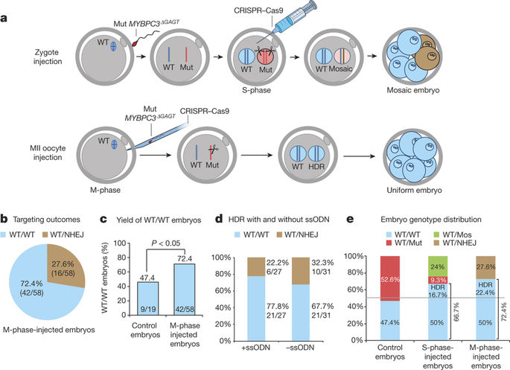
Summary of Experiment
Experiment 2: Targeting Gametes Eliminates Mosaicism
Sperm carries the mutation, not the oocyte.
Gene correction in M-phase-injected human embryos
CRISPR–Cas9 was co-injected with sperm into the oocyte during fertilization by intracytoplasmic sperm injection (ICSI)
Genome editing occurs when there is one copy of mutant allele. This reduces mosaicism, and the extended time in the zygote reduces CRISPR to edit during DNA replication.
Results:
Difference between the two Experimental Designs

Slide 26
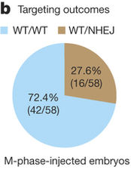
Results of Second Experiment
-27.6% of blastomeres were uniformly heterozygous, carrying an intact wild-type maternal allele with a NHEJ-repaired mutant paternal allele.
-72.4% were homozygous wild type, compared to the zygotes infected with CRISPR, only 66.7% were uniformly homozygous.
-No mosaicism occurred!
-Embryos successfully gene-corrected.
From Results of Experiment

Slide 27
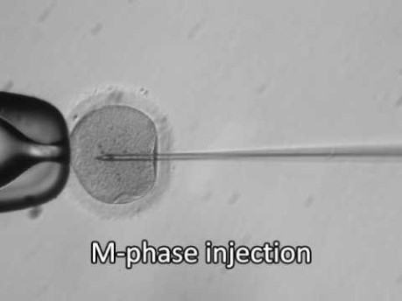
Video of the CRISPR/Cas9 injection into human oocytes and zygotes
https://www.youtube.com/watch?v=lZyqUeEHECY&feature=emb_title

Slide 28
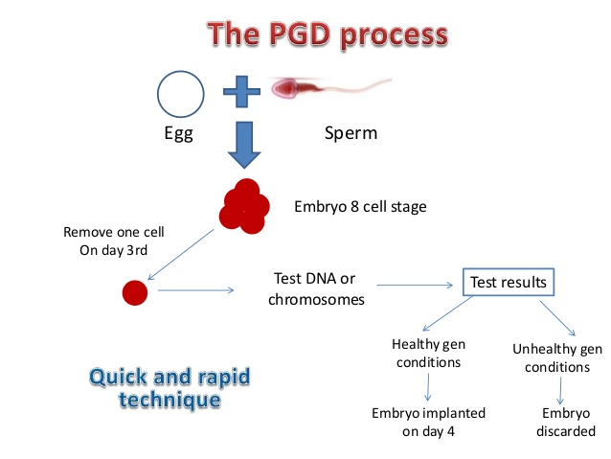
Discussion & Evaluation of Experiment
Experiment shows that preimplantation genetic diagnosis (PGD), the genetic profiling of embryos prior to implantation may be a viable options for heterozygous couples at risk of producing affected offspring.
Before, 50% of embryos would carrying mutations (because it is a heterozygous mutation). With PGD, one can save large amounts of embryo for birth.
For HDR repair, cells used maternal allele as template not the exogenous material from CRISPR. Repair systems different from adult cells, and may be because of evolutionary defense mechanism.
This experiment can be a model for future genetic-editing on humans.
From dynamicfertility.com

Slide 29
Critique & Issues
Despite remarkable targeting and high HDR efficacy, some CRISPR–Cas9-treated human embryos demonstrated NHEJ mutations in experimentation which cannot be used on the human germline, as it can cause unwanted gene mutations.
Applicability of method to other heterozygous mutations; it is not a universal gene-correcting method, and has only targeted one gene mutation.
Used a heterozygous mutation, not a homozygous mutation, where both alleles are mutant and HDR repair cannot be used.
The human embryos were cultured in a lab, not in the human body (for ethical concerns). Interactions with other molecules in the mother’s body may produce unwanted effects.
Ethical Concerns: To what extent should human embryos be researched on, and gene-edited? The idea of gene-editing on humans poses moral and legal concerns. We must learn from the He Jiankui incident (a scientist who illegally created the world’s first gene-edited human babies, reducing their risk of contracting HIV) on the importance of safely conducting research. Researchers, politicians, and bioethicists must come together to have effective discussions on this advancing technology.

Slide 30
Some Latest News on CRISPR
“CRISPR gene cuts may offer new way to chart human genome.” From ScienceDaily
“Light-activated 'CRISPR' triggers precision gene editing and super-fast DNA repair”From ScienceDaily
“New genetic method of using CRISPR to eliminate COVID-19 virus genomes in cells.” From Stanford Bioengineering. Now in animal trial stage.
“The CRISPR-baby scandal: what’s next for human gene-editing” (He Jiankui incident). From Nature Journal.
“CRISPR gene editing produces unwanted DNA deletions.” From Nature Journal.

Slide 31
Summary
Scientists corrected the gene MYBPC3 that causes hypertrophic cardiomyopathy in human embyros, using CRISPR-CAS9 and the cell’s repair system (HDR).
First, scientists tested the CRISPR-CAS9 on zygotes. Unsuccessful, because it led to mosaicism of cells.
Then, scientist co-injected CRISPR-CAS9 with sperm into oocytes. No mosaicism occurred, and it had a higher HDR efficiency then the previous results.
Advantage: May significantly help couples produce offspring with no risk of disease
Issues: Need to make cells use HDR repair for clinical application. NHEJ repair causes unwanted mutations. Cannot be used on all heterozygous mutation, or any homozygous mutations. Embryos were cultured in labs, not developed in humans. Ethical concerns apply as well.

Slide 32
Citations
Blogger, Guest. CRISPR 101: Non-Homologous End Joining. http://blog.addgene.org/crispr-101-non-homologous-end-joining. Accessed 27 Dec. 2017.
Cortez, Chari. CRISPR 101: Homology Directed Repair. http://blog.addgene.org/crispr-101-homology-directed-repair. Accessed 14 Jan. 2018.
Liang, Puping, et al. “CRISPR/Cas9-Mediated Gene Editing in Human Tripronuclear Zygotes.” Protein & Cell, vol. 6, no. 5, May 2015, pp. 363–372, doi:10.1007/s13238-015-0153-5.
Life Sciences Cyberbridge. http://cyberbridge.mcb.harvard.edu/mitosis_4.html. Accessed 14 Jan. 2018.
Ma, Hong, et al. “Correction of a Pathogenic Gene Mutation in Human Embryos.” Nature, vol. 548, Aug. 2017, p. 413.
Mosaicism: MedlinePlus Medical Encyclopedia. https://medlineplus.gov/ency/article/001317.htm. Accessed 14 Jan. 2018.
“What Is CRISPR-Cas9?” Yourgenome, /facts/what-is-crispr-cas9. Accessed 14 Jan. 2018.
http://www.ebi.ac.uk/interpro/potm/2004_7/Page2.htm. Accessed 13 Jan. 2018.

Slide 33
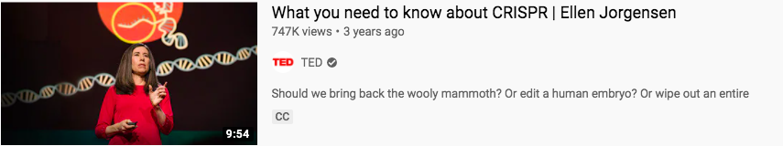
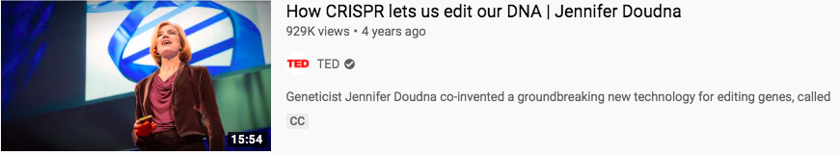
Learn more about CRISPR!
https://www.youtube.com/watch?v=1BXYSGepx7Q
https://www.youtube.com/watch?v=TdBAHexVYzc

Slide 34

Discussion
How can CRISPR help us win the fight against COVID-19?
CRISPR vs COVID: gene-targeting and gene-editing technology; research is based on the mechanism that bacteria naturally use to fight viruses.
CRISPR Advances Covid-19 Testing
CRISPR can be modified to target nearly any genetic sequence, it can be used to detect SARS-CoV-2 RNA in a patient sample.
CRISPR Helps Engineer Future Treatments
Understanding past viruses and how a pathogenic disease operates at the host-pathogen interface.
CRISPR-based genome engineering enables researchers to study how SARS-CoV-2 interacts with human cells and generate the appropriate cell models that could lead to faster discovery of a potential new treatment or an existing drug combination that may provide a treatment solution.

Slide 35
Discussion
Ethics of CRISPR
What is CRISPR used for that may be seen as controversial?
Turning pigs into organ donors
Modifying human embryos
Designer Babies
Otherwise, CRISPR is currently used to genetically modify food, change color of flowers, and genetically modify some farm animals.

